Slide 1
Food Donation System
TS - WEB TRACK CAPSTONE PROJECT
Presented By:
1.Anjitha Nair-GEC Idukki
2.Christina Susan Jacob-GEC Idukki
3.Fathima NK-GEC Idukki
4.Shabana KM-GEC Idukki
Guided By: Ms. Vidhi Pandya

Slide 2
OUTLINE
Abstract
Problem Statement
Tools and Technology
System Requirement
Modules of Application
Design

Slide 3
Outline
Timeline Chart
Application Demonstration
Limitation of Project
Future Work
Team Members
References

Slide 4
Abstract
It is a PHP/MySql project that helps agencies or event management to provide food for orphanages or other organizations in an area by simply registering on the website
The system has two user interfaces which are the Organization side and the Event management side
The Organization side consists of the profile of the organization and the nearby event details and booking page
The Event management side serves the details of events and the amount of food and after that displays the nearby organizations that match the conditions.

Slide 5
Problem Statement
To develop a web-based application that helps agencies or even management to provide food for orphanages or other organizations in an area by simply registering their information on the website

Slide 6
Tools and Technology
Language used:-PHP
Database:-MySql
User Interface Design:-HTML, CSS, Javascript, Bootstrap
Web Browser:-Google Chrome
Software needed:-XAMPP

Slide 7
System Requirement
Software Specifications​ | Hardware Specification​
Operating System-Mac OS X 10.11 ​ | Ram-6GB or higher​
Web server-Xampp​ | Storage-80 GB DISK space​

Slide 8
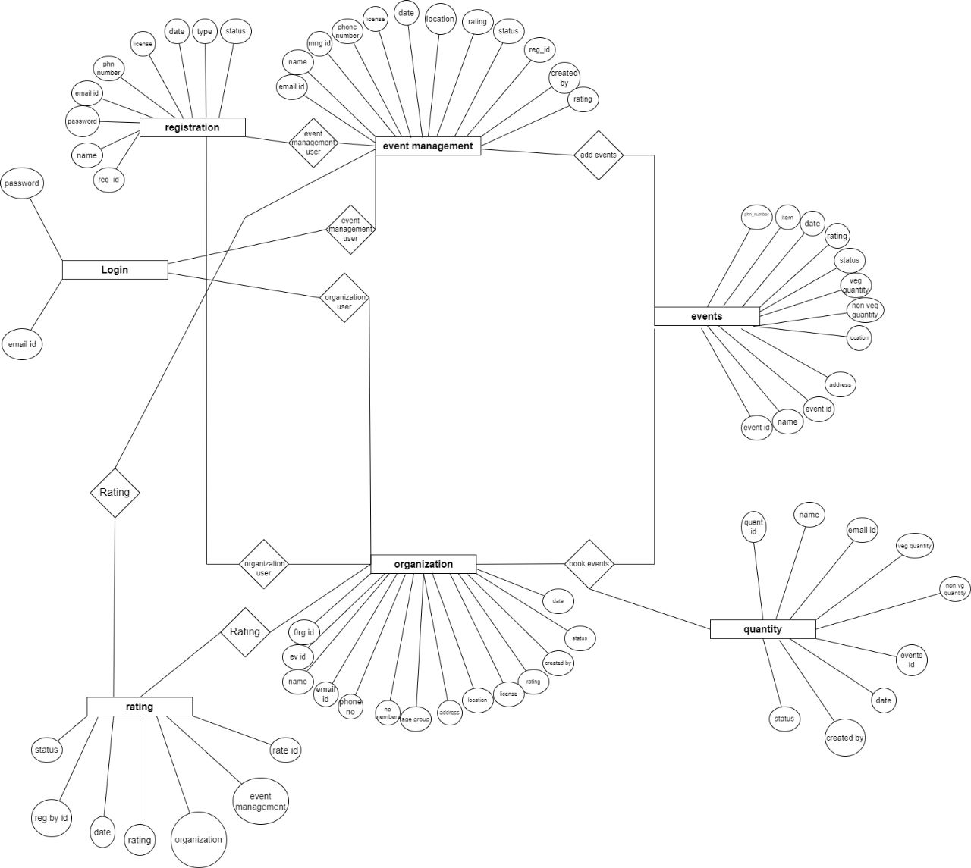
Modules

Slide 9
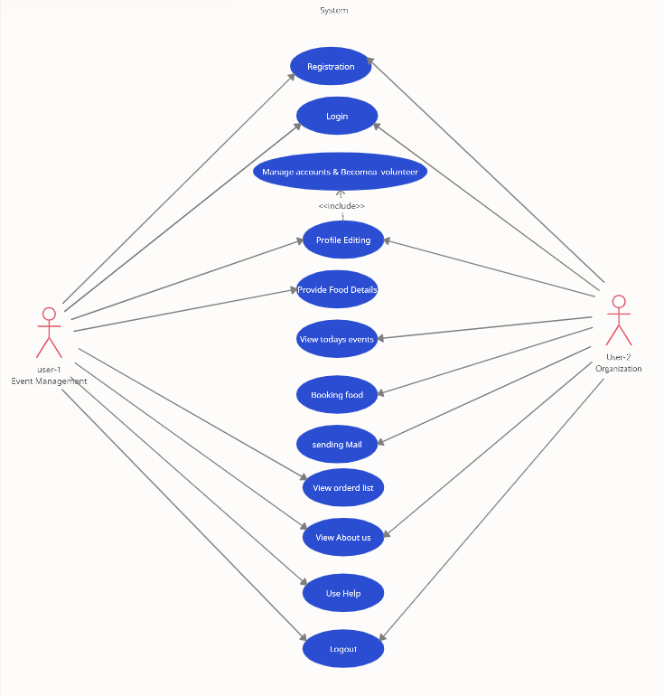
Design

Slide 10
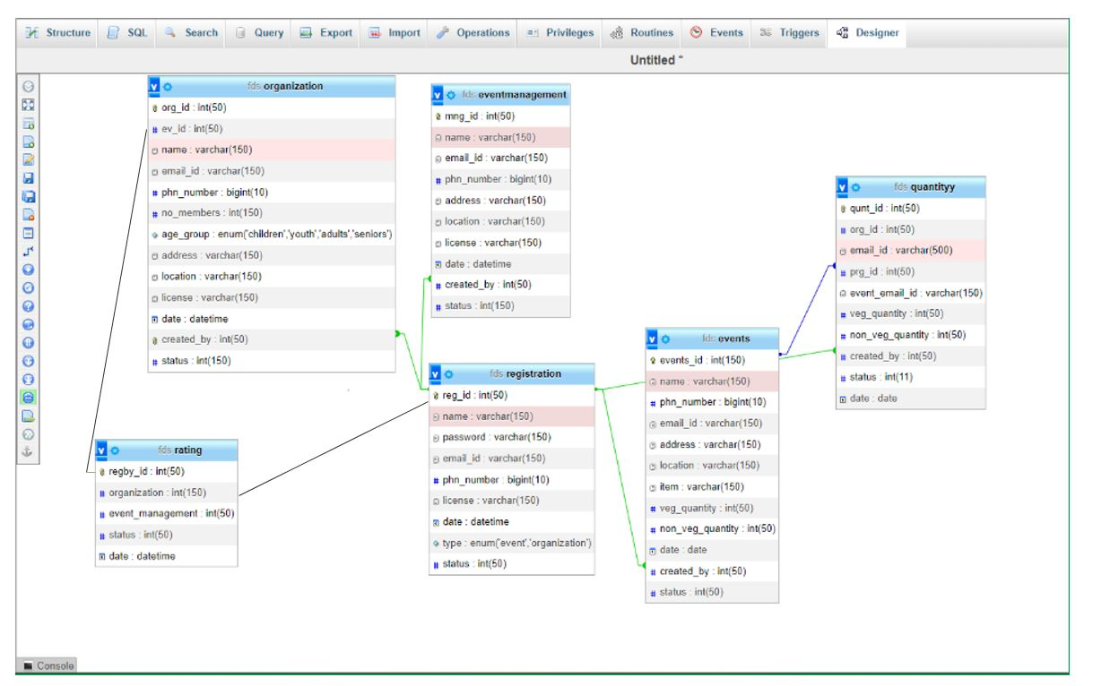
Design

Slide 11
Application Demonstration

Slide 12
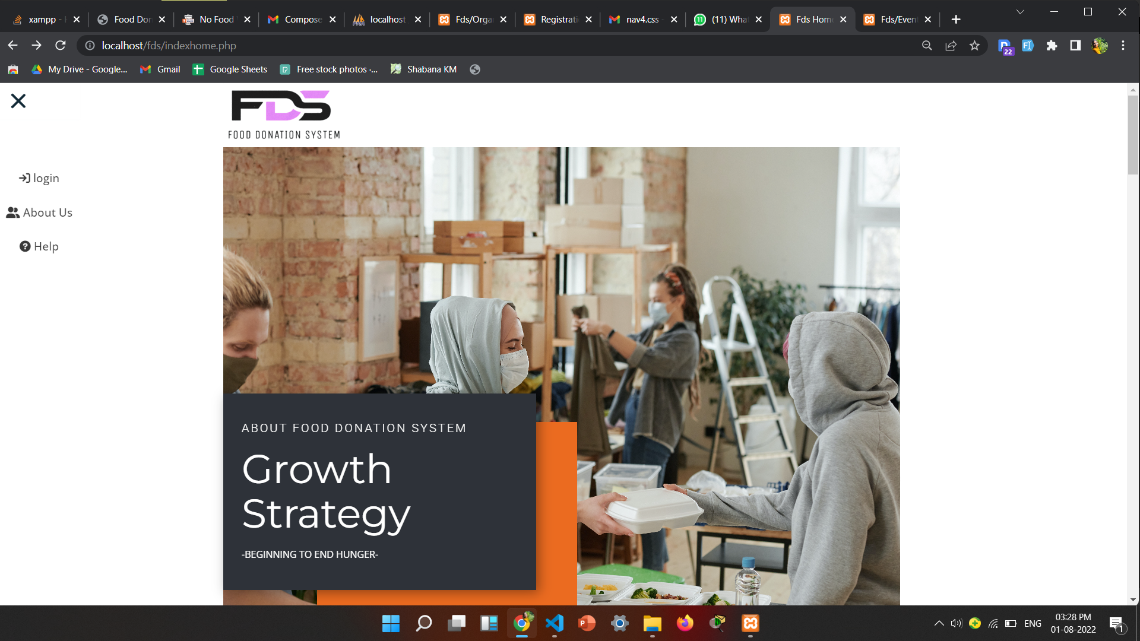
Index Home Page

Slide 13
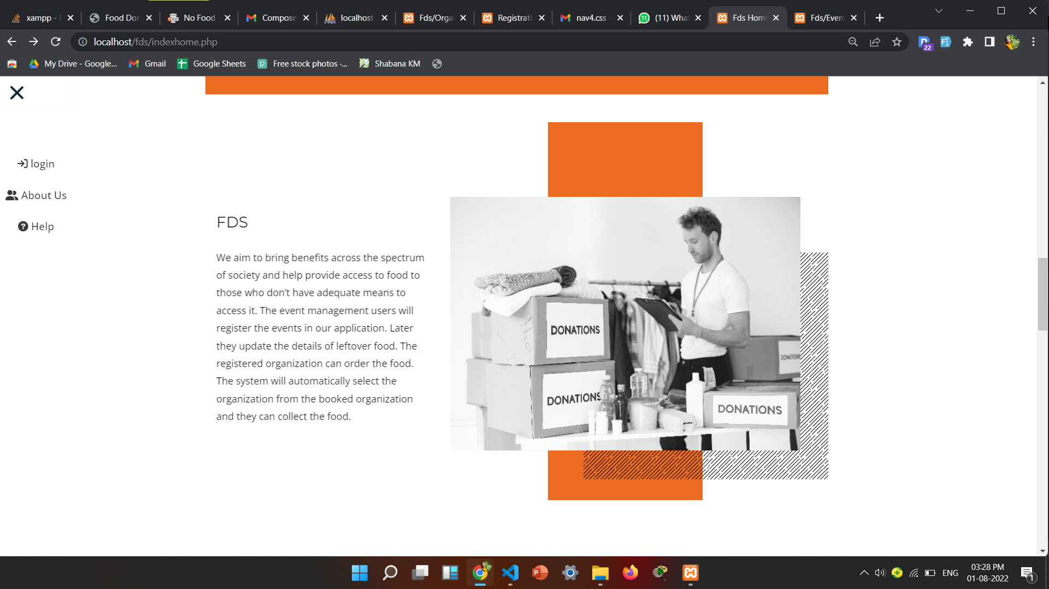
About Us

Slide 14
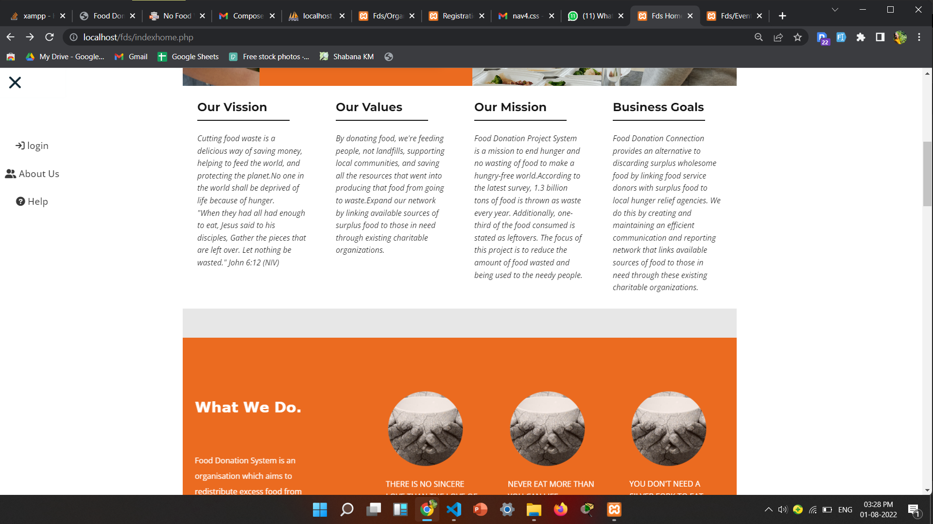

Slide 15
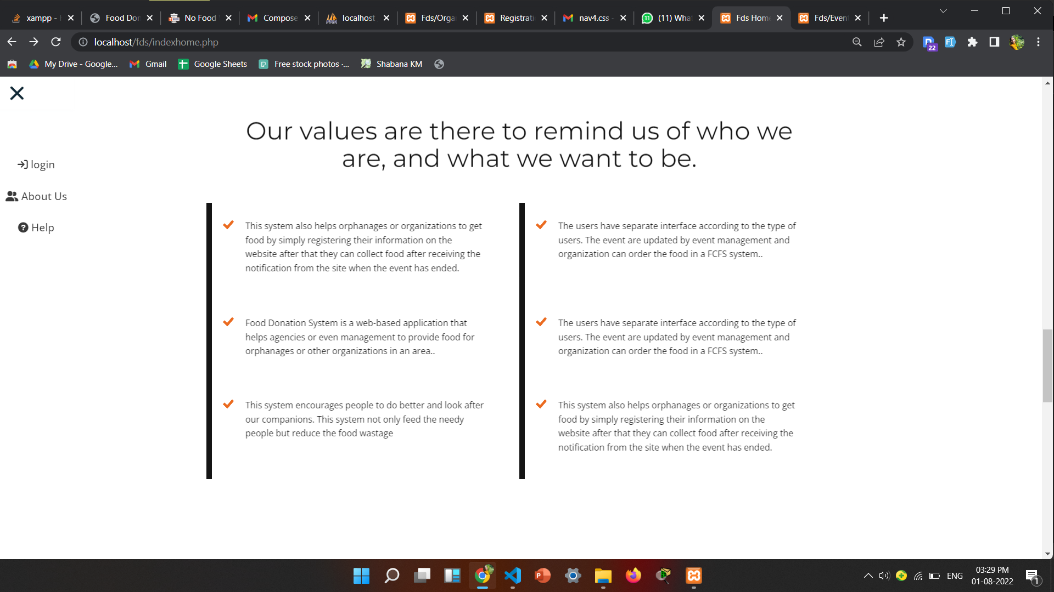
Registration Page

Slide 16
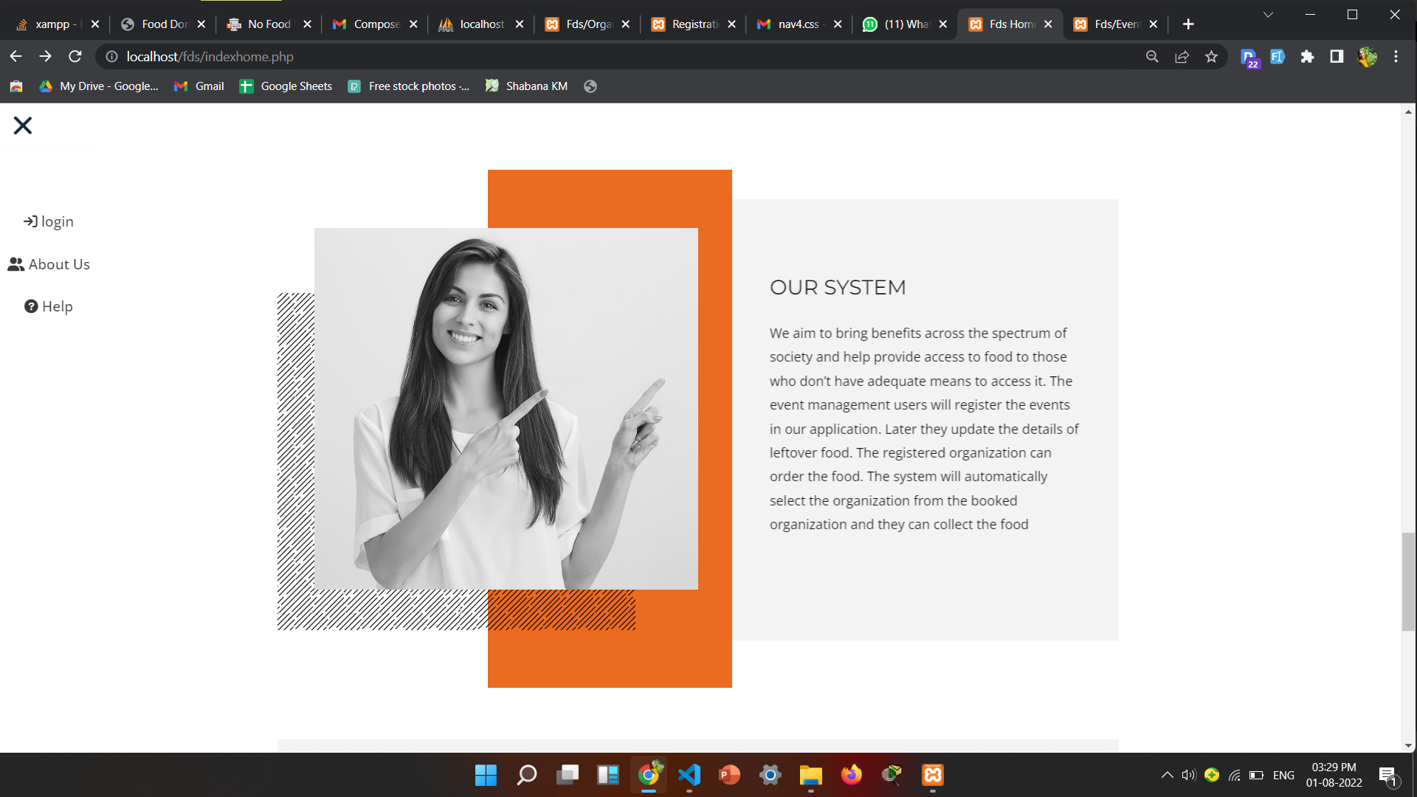
Profile

Slide 17
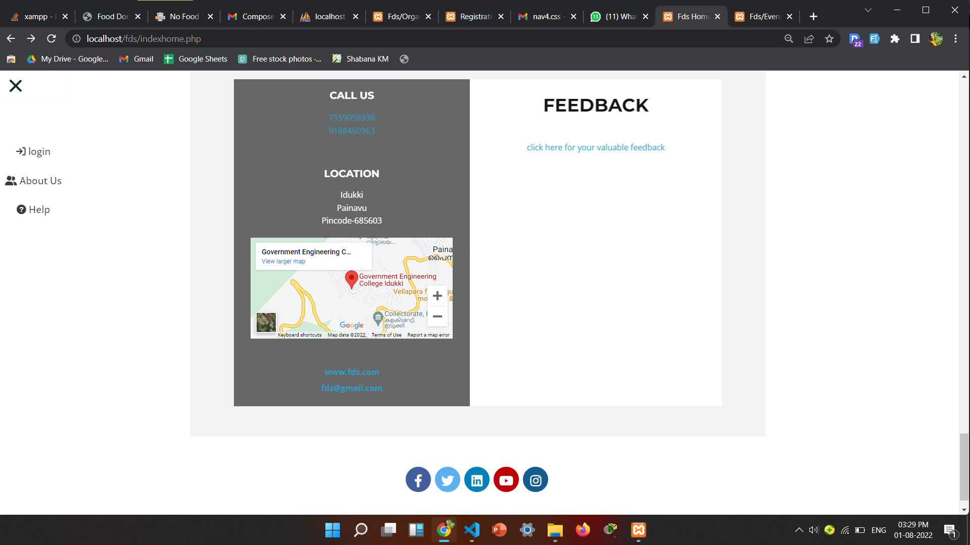
About

Slide 18
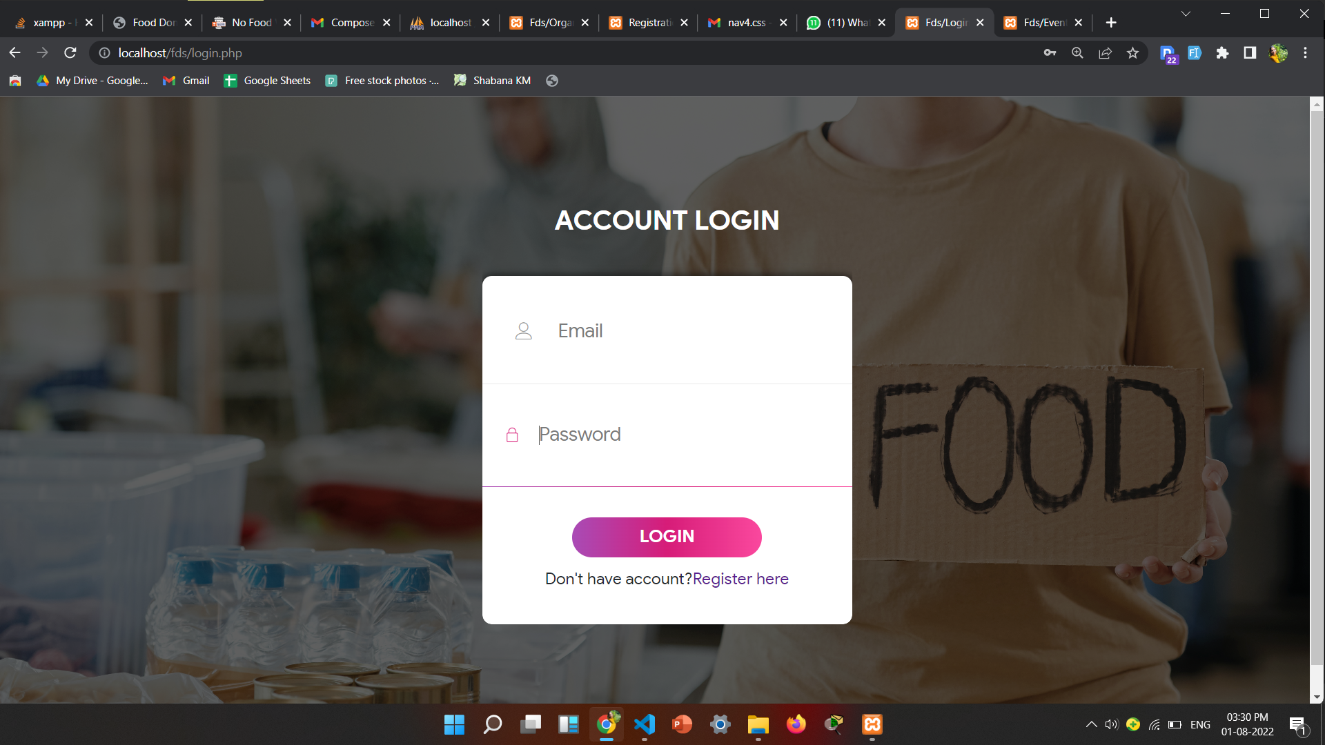
Login Page

Slide 19
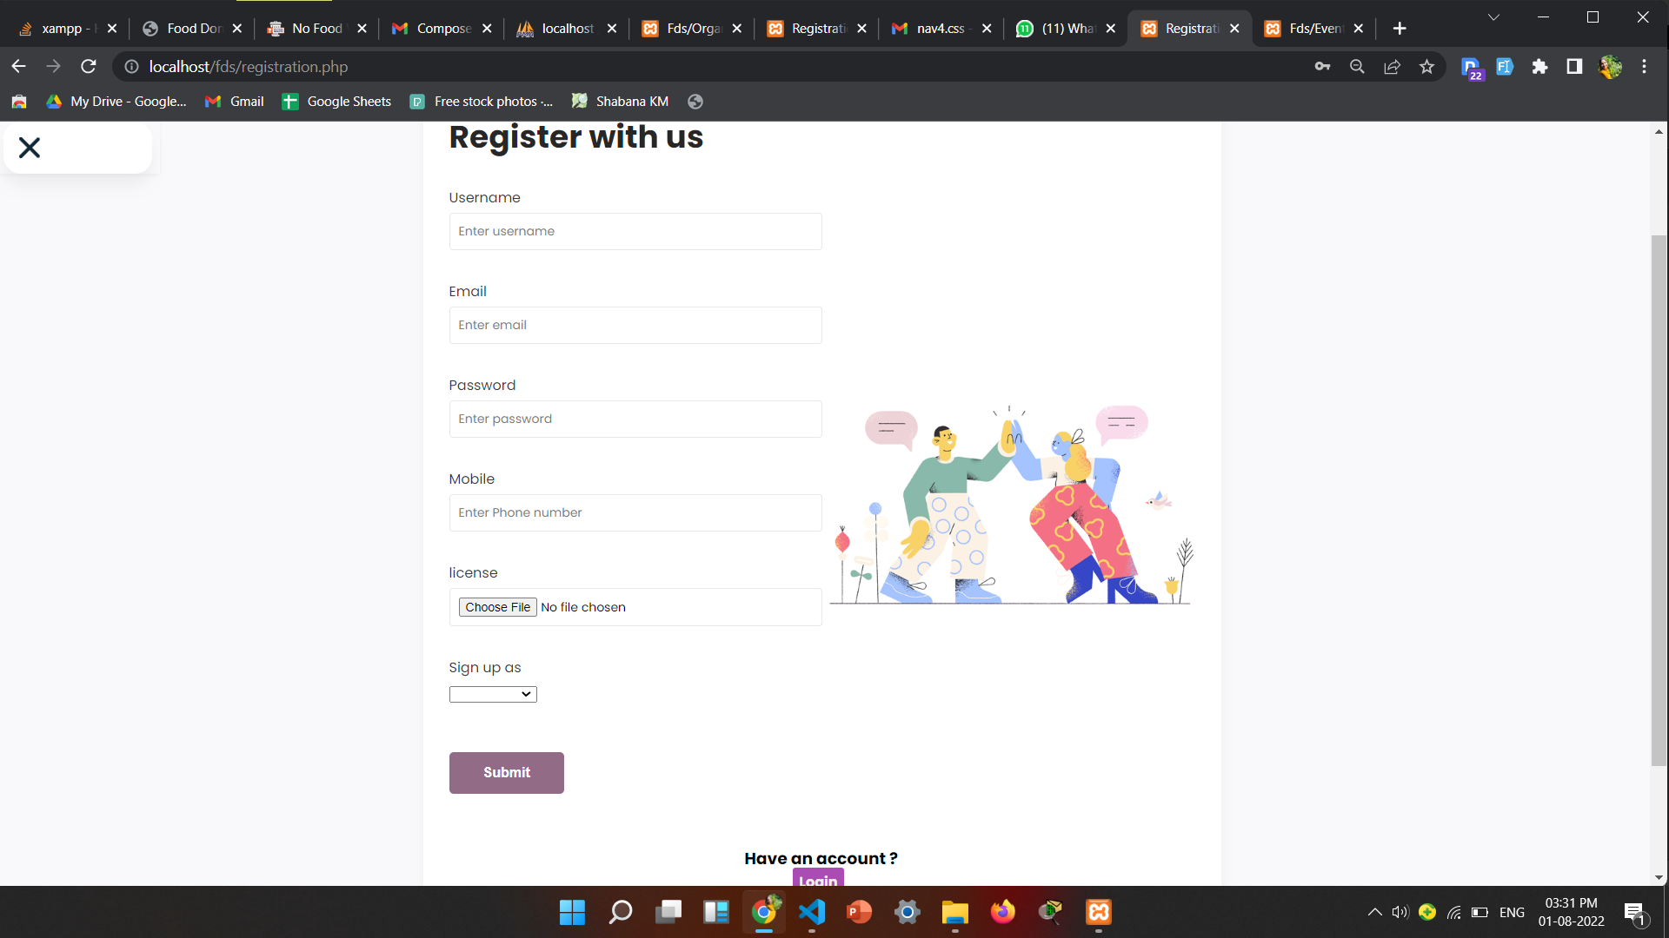
Registration us event management

Slide 20

Home Page(event management)

Slide 21
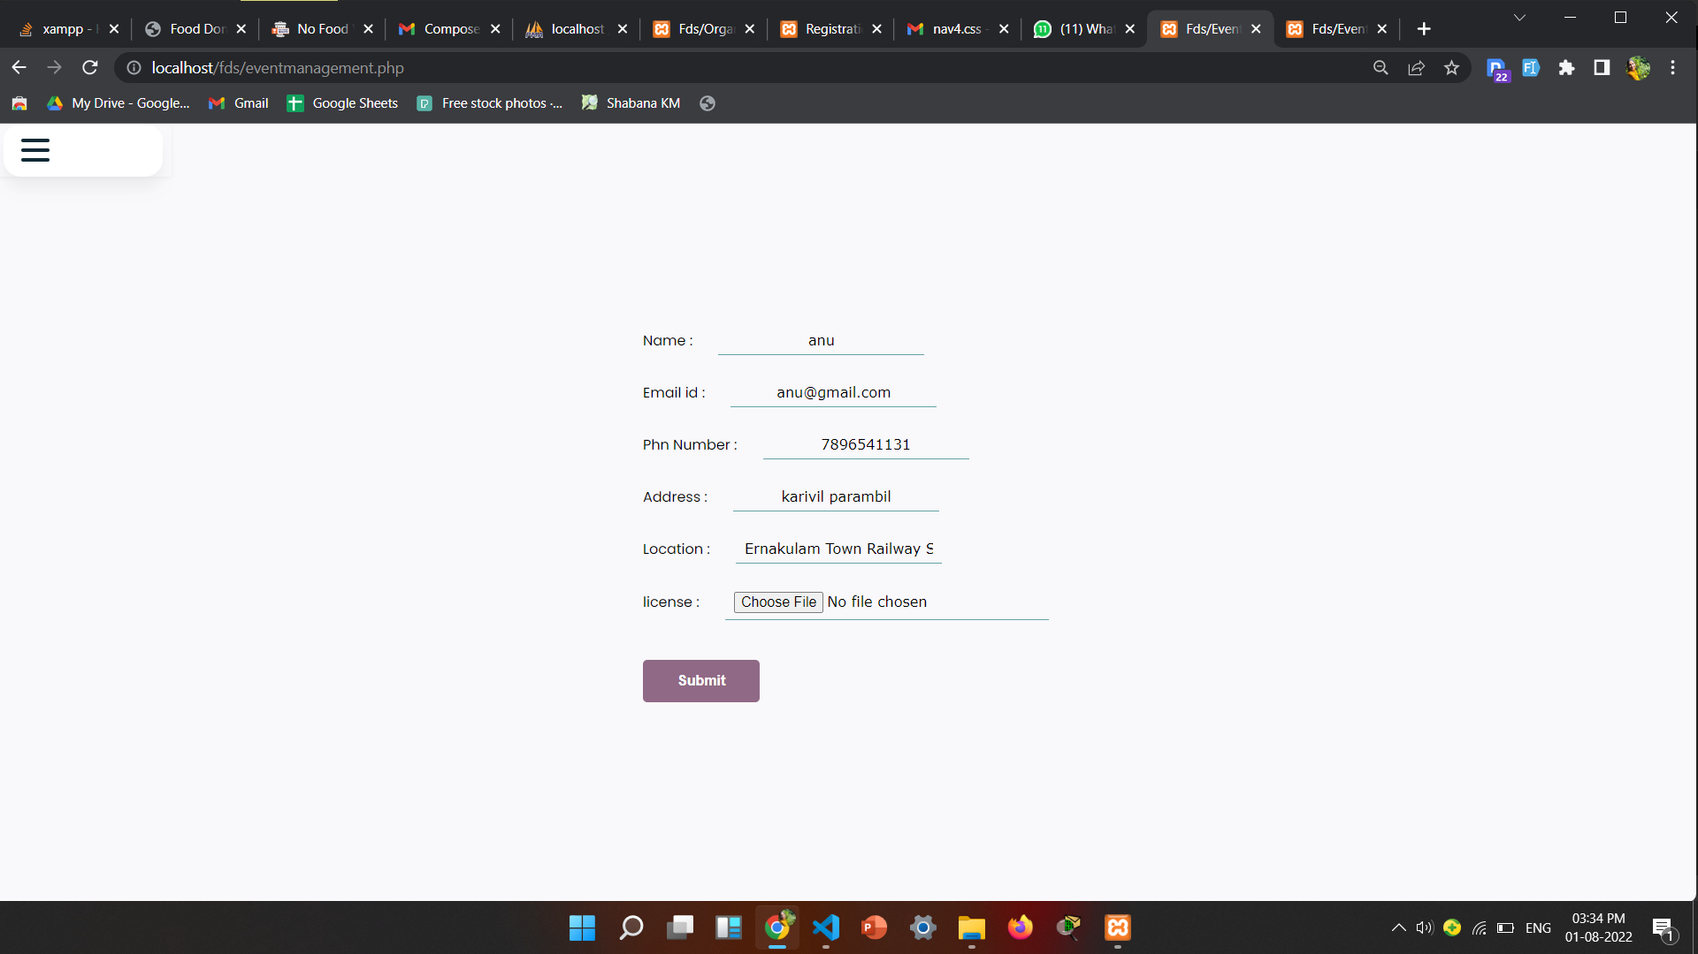
Profile(Event Management)

Slide 22
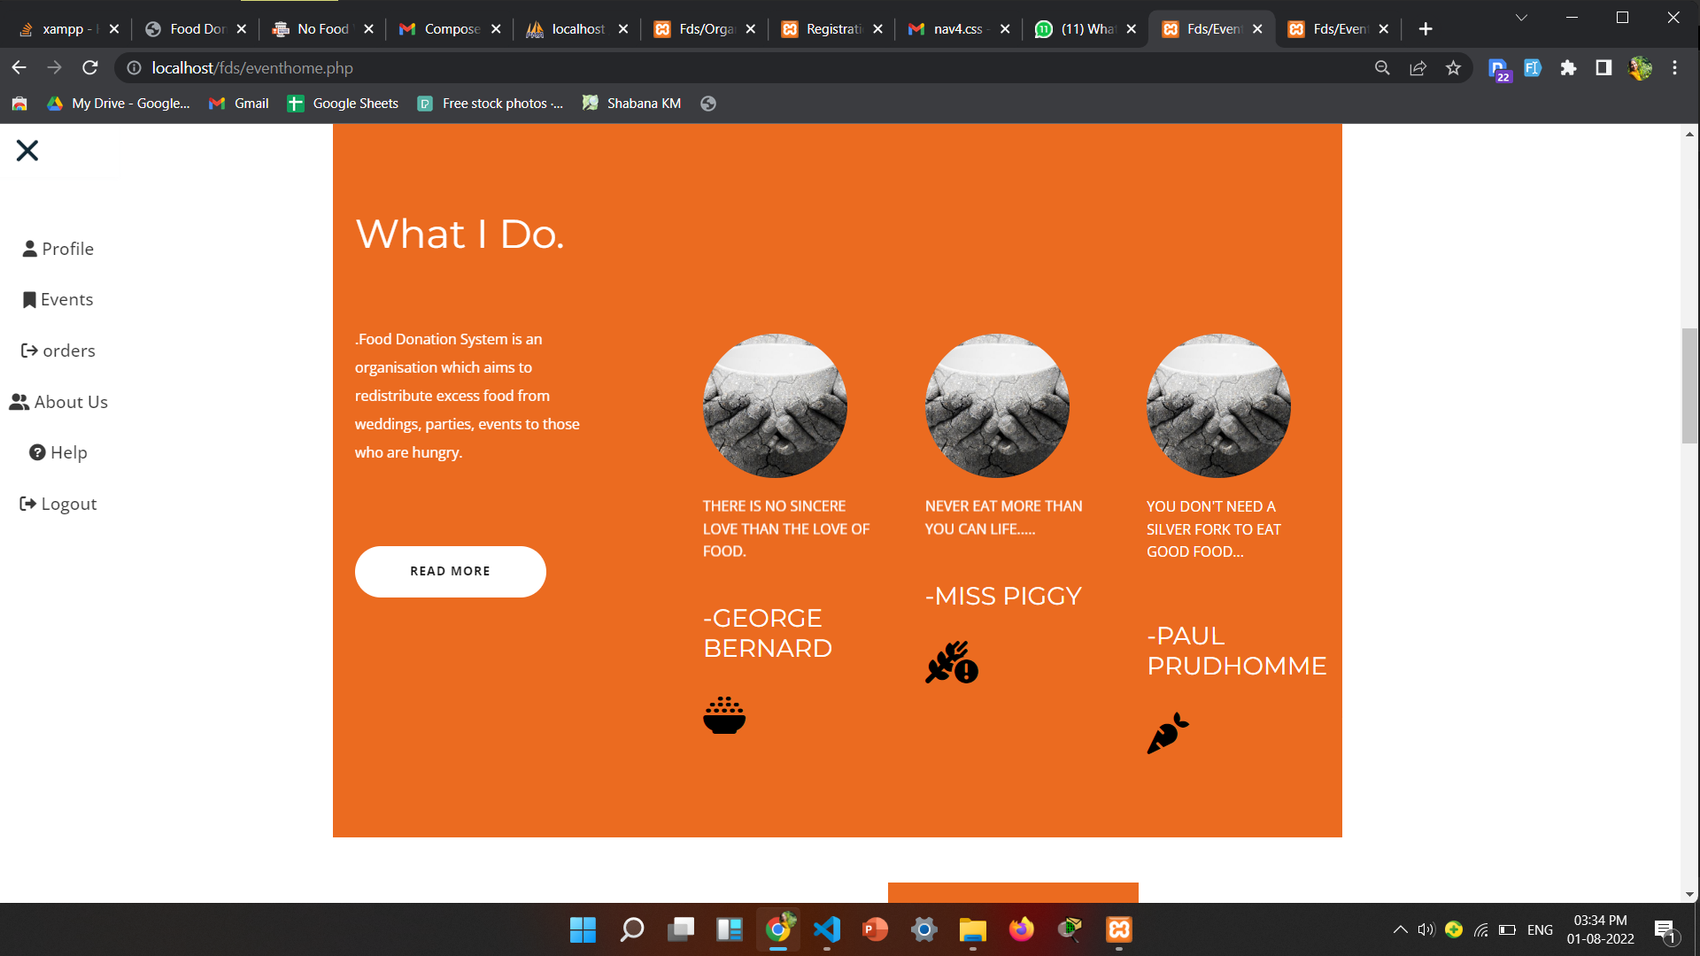
About Us Page

Slide 23
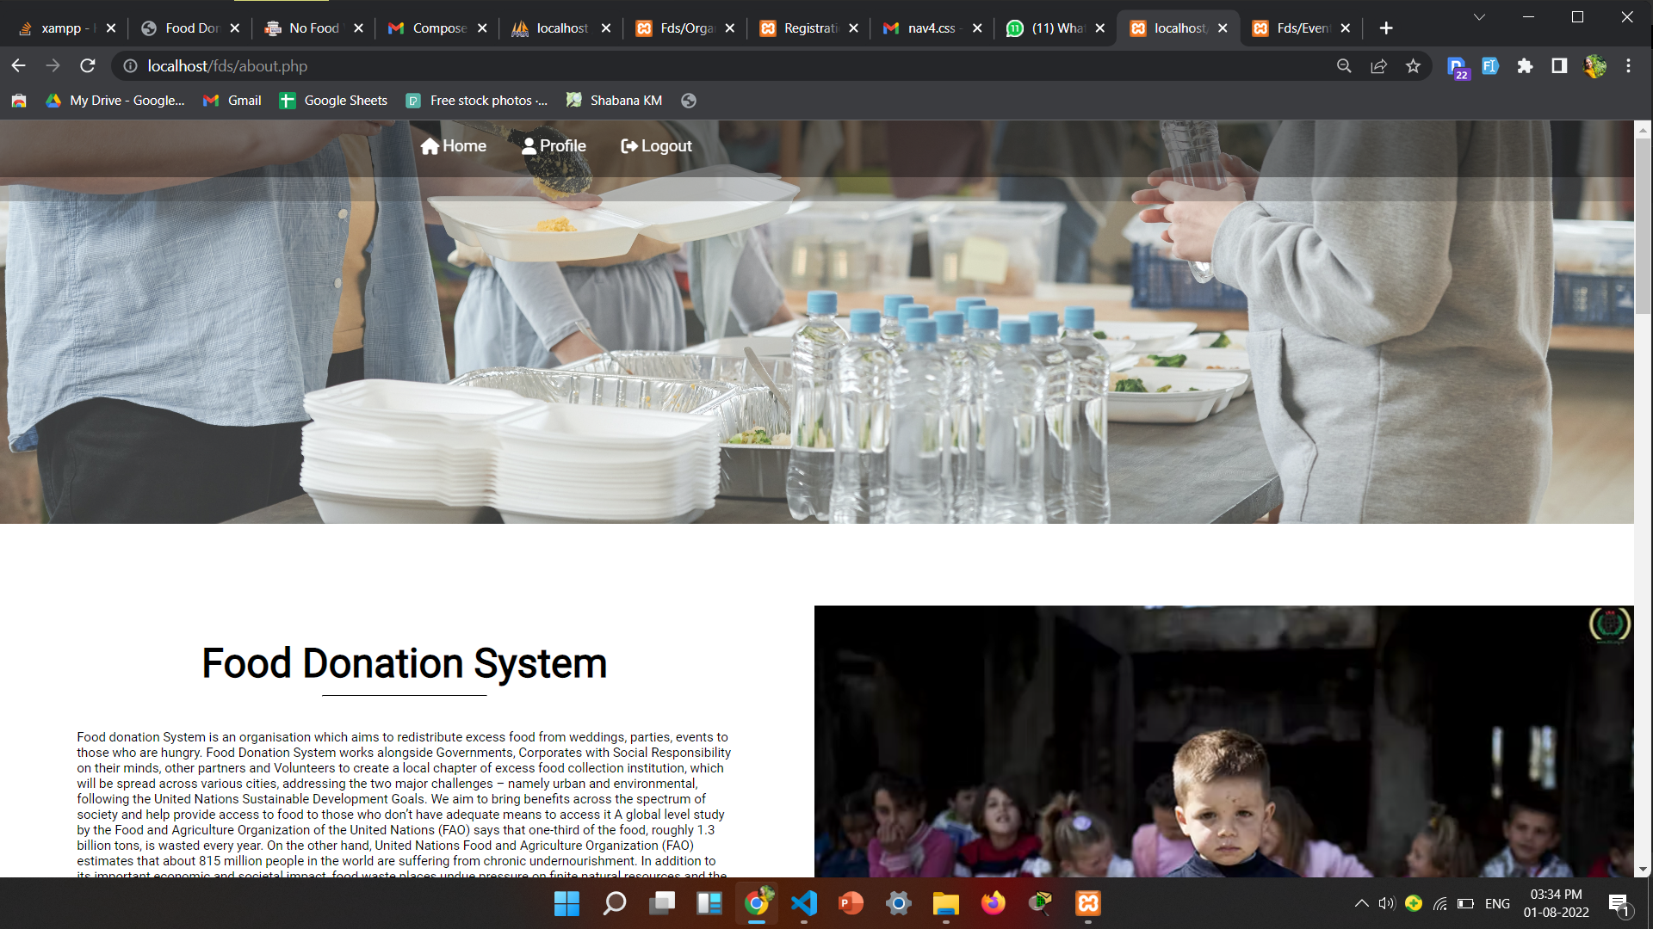
About Us

Slide 24
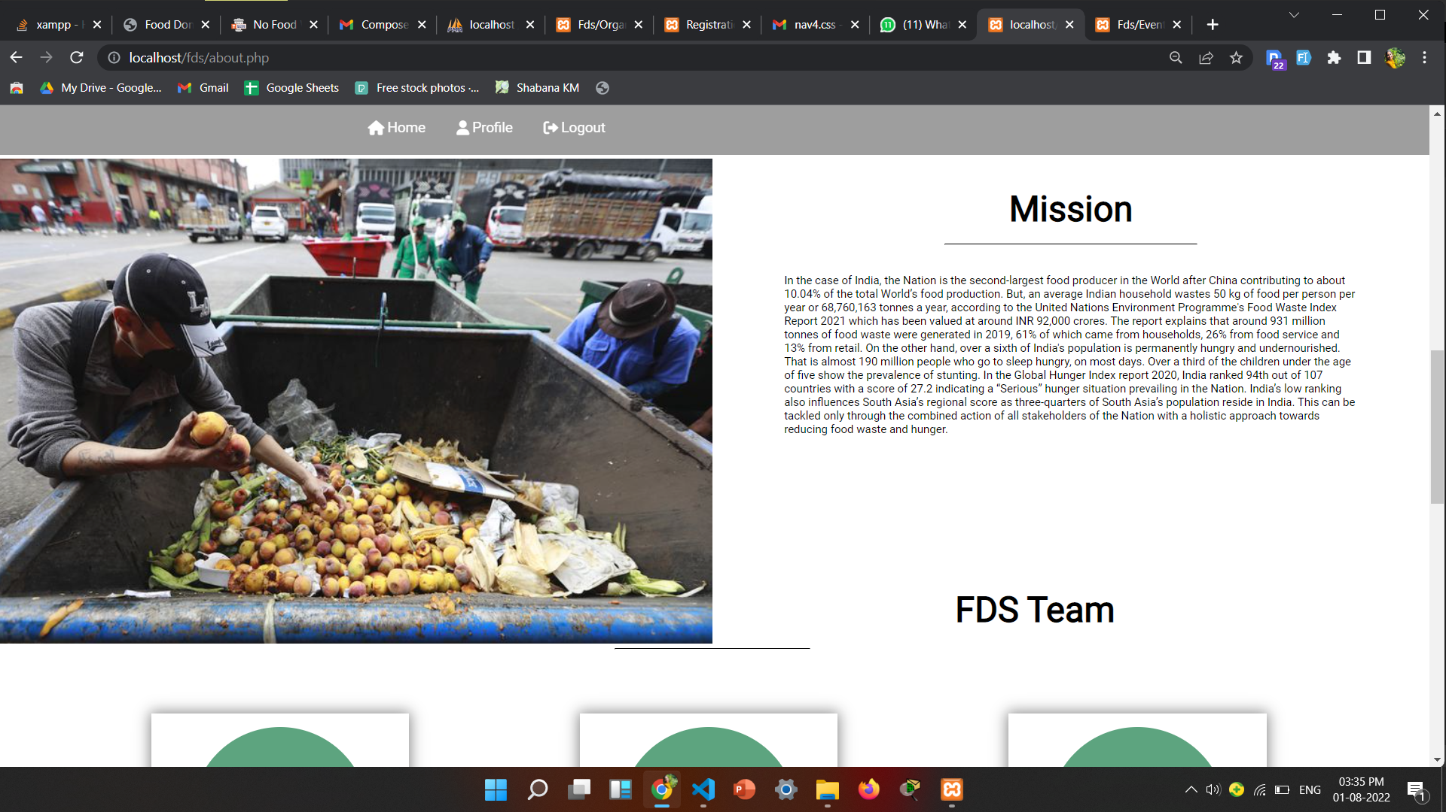
About

Slide 25
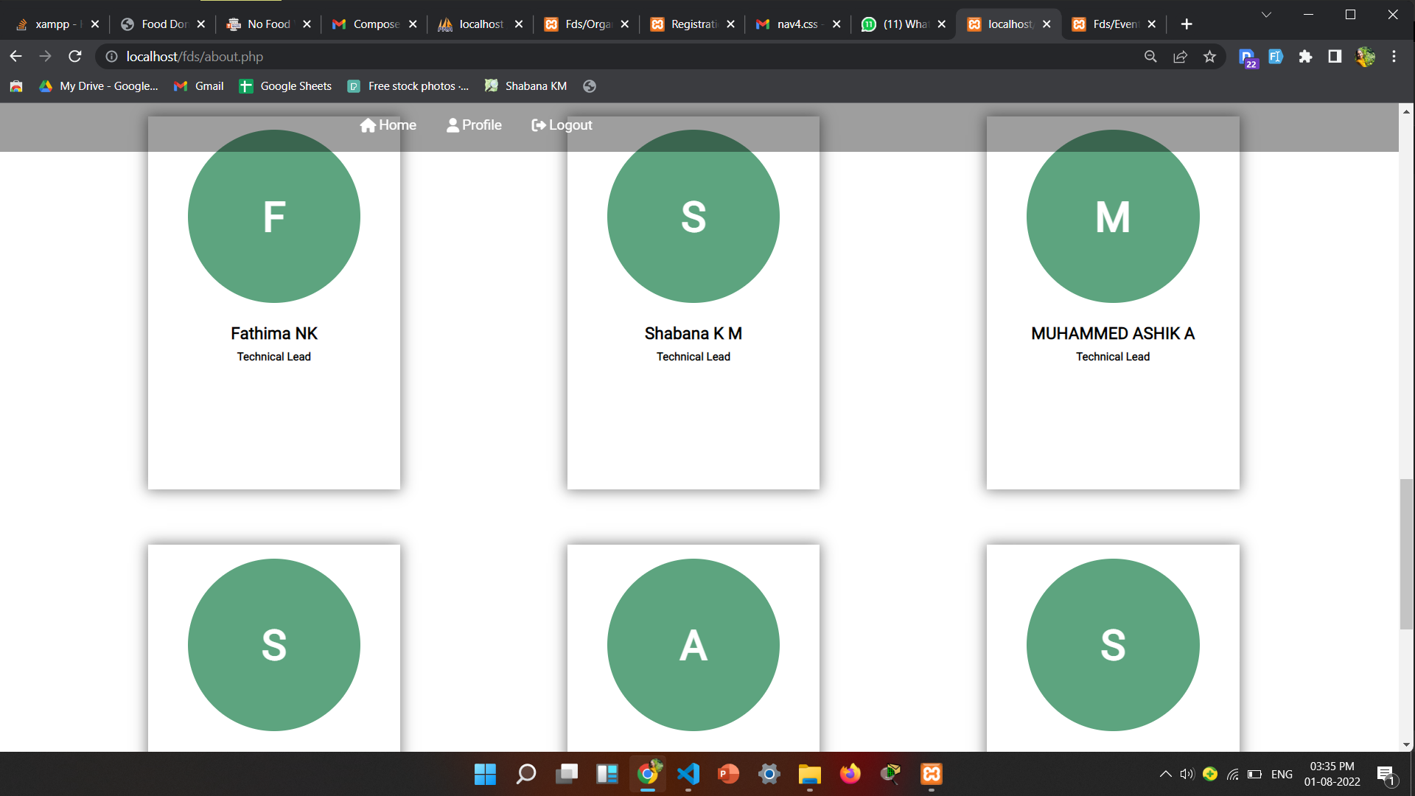
About Us

Slide 26
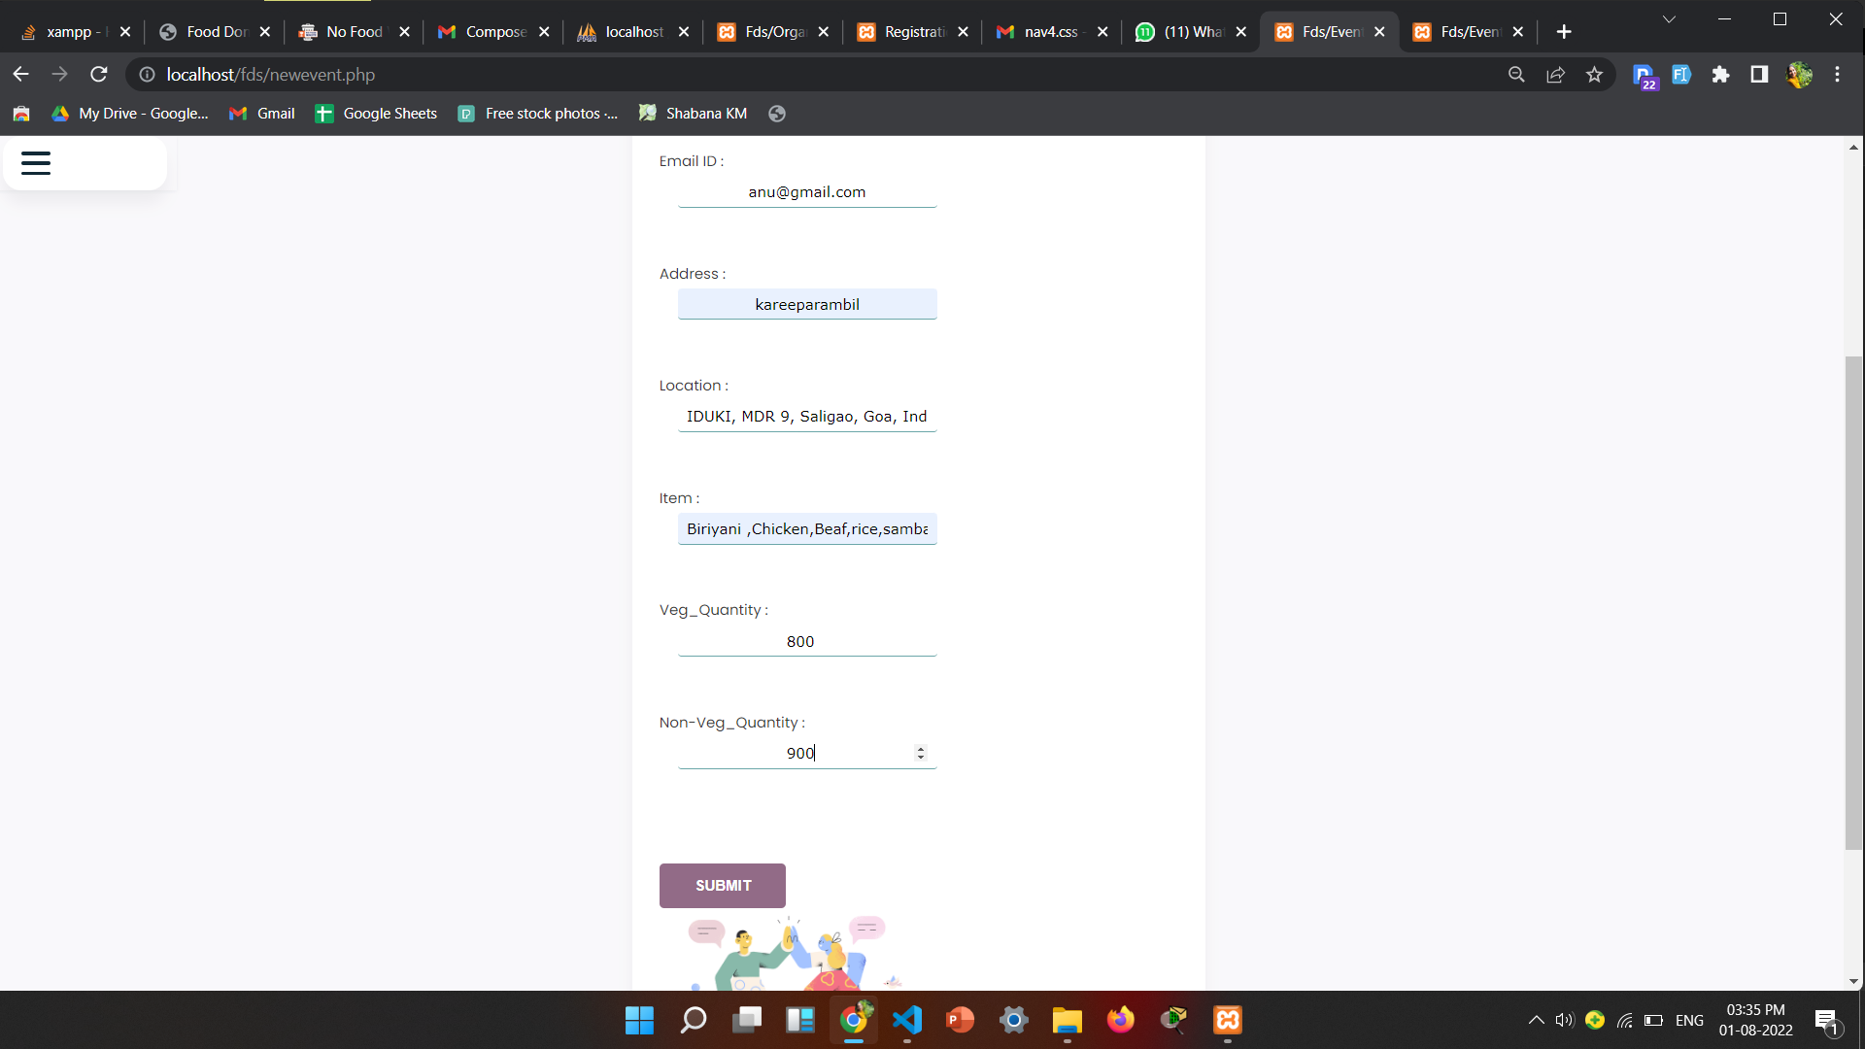
Add New Event

Slide 27
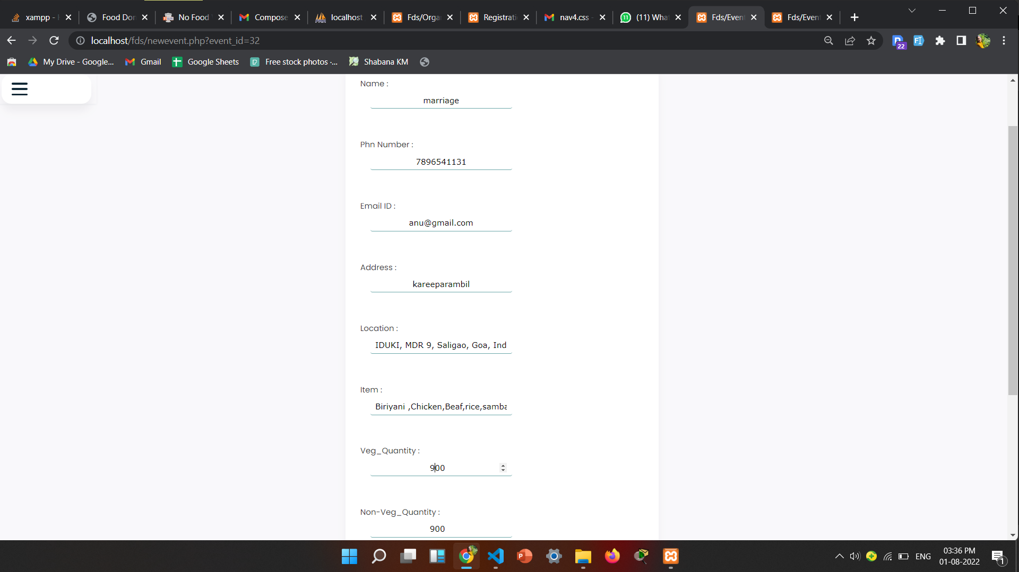
Edit Event

Slide 28
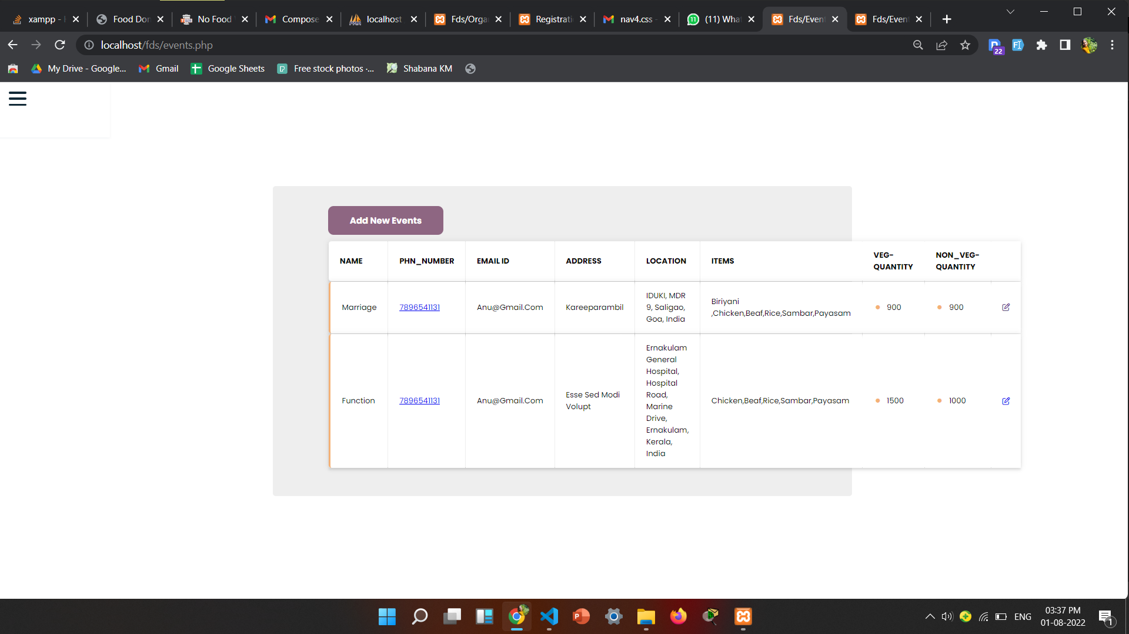
Events(Event Management )

Slide 29
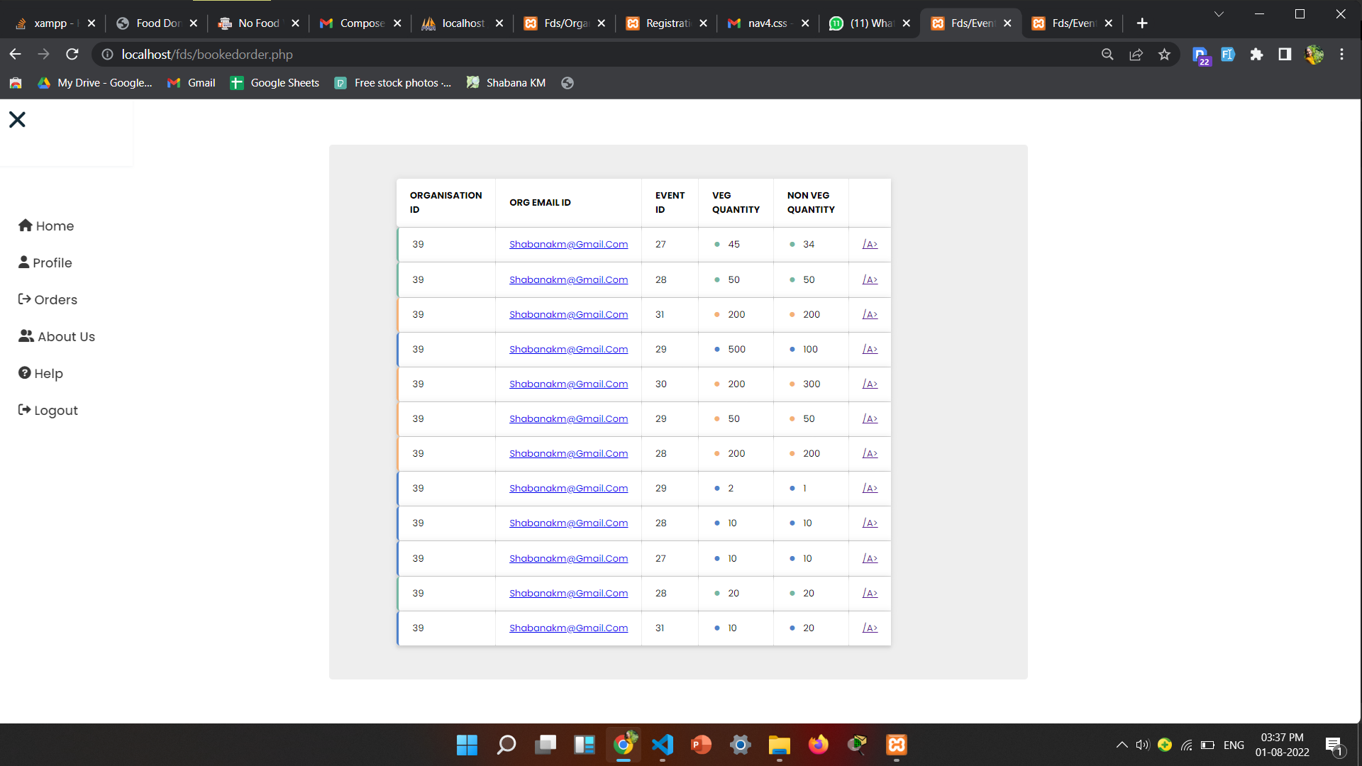
Booked Order

Slide 30
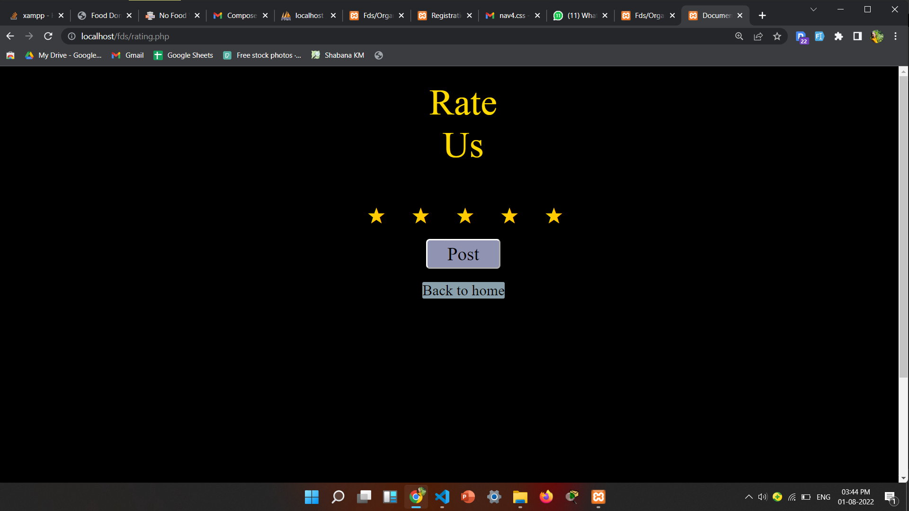
Rating

Slide 31
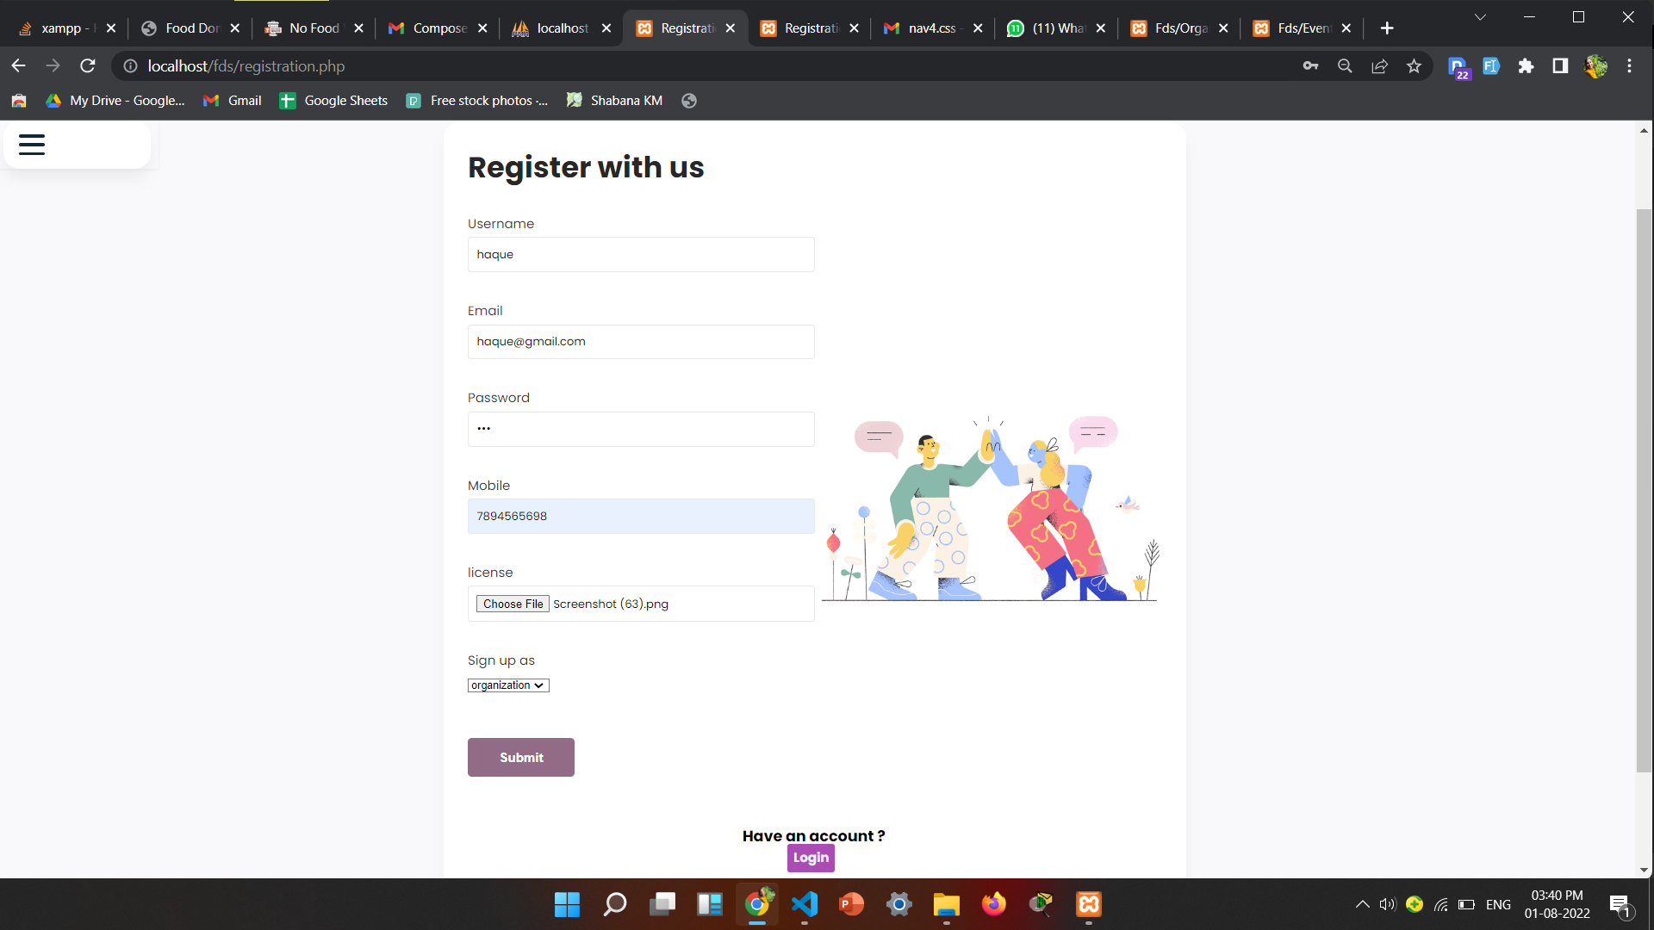
Registration as organization

Slide 32
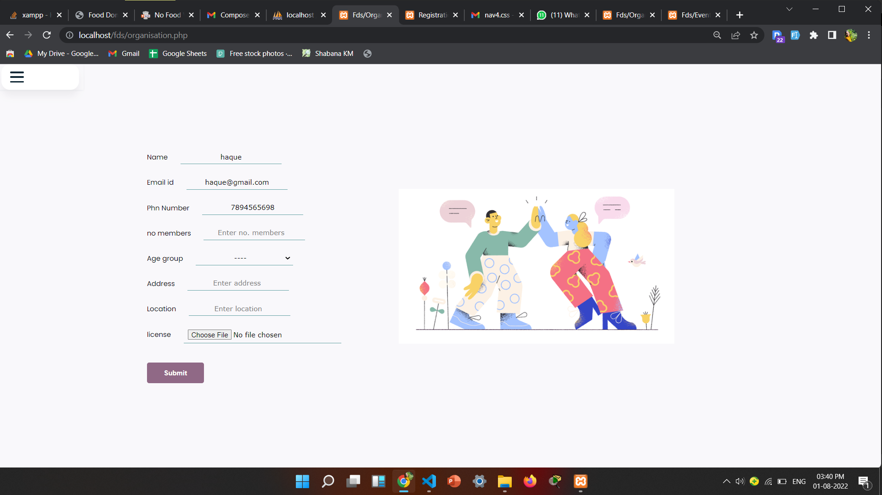
Profile(Organization)

Slide 33
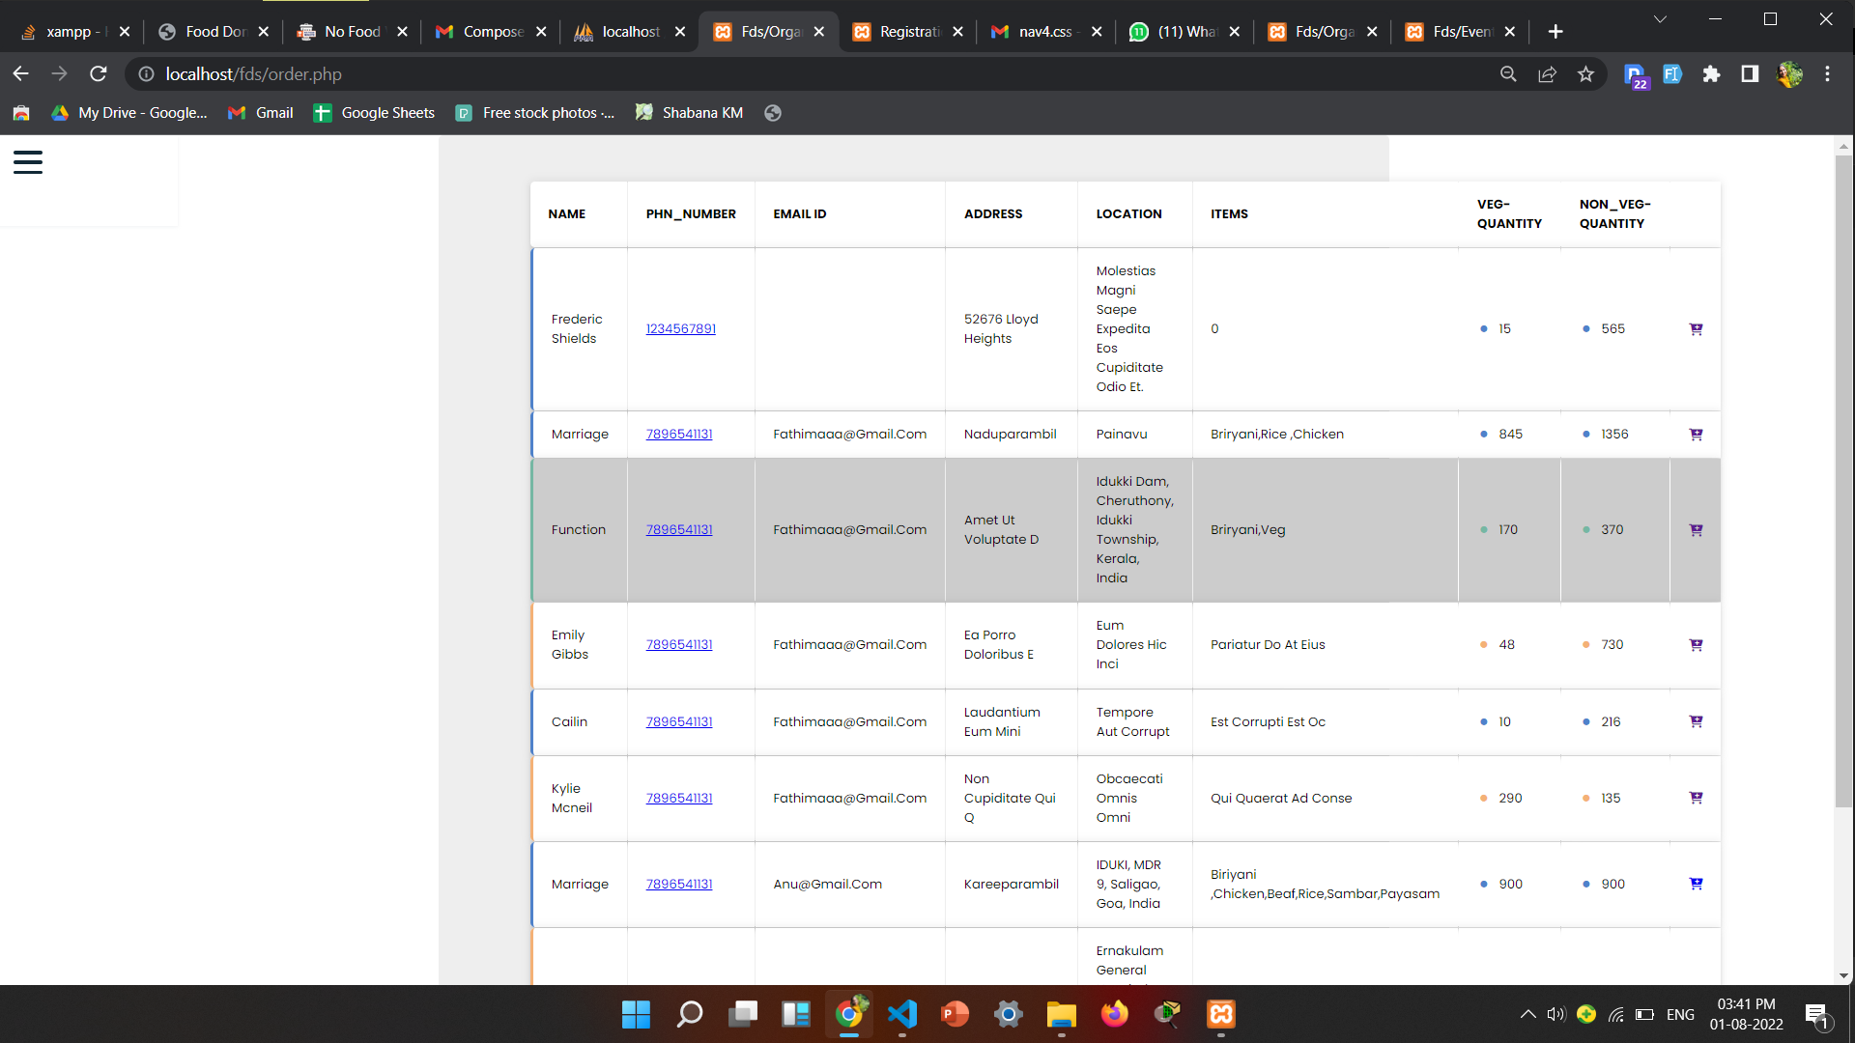
Today's Events

Slide 34
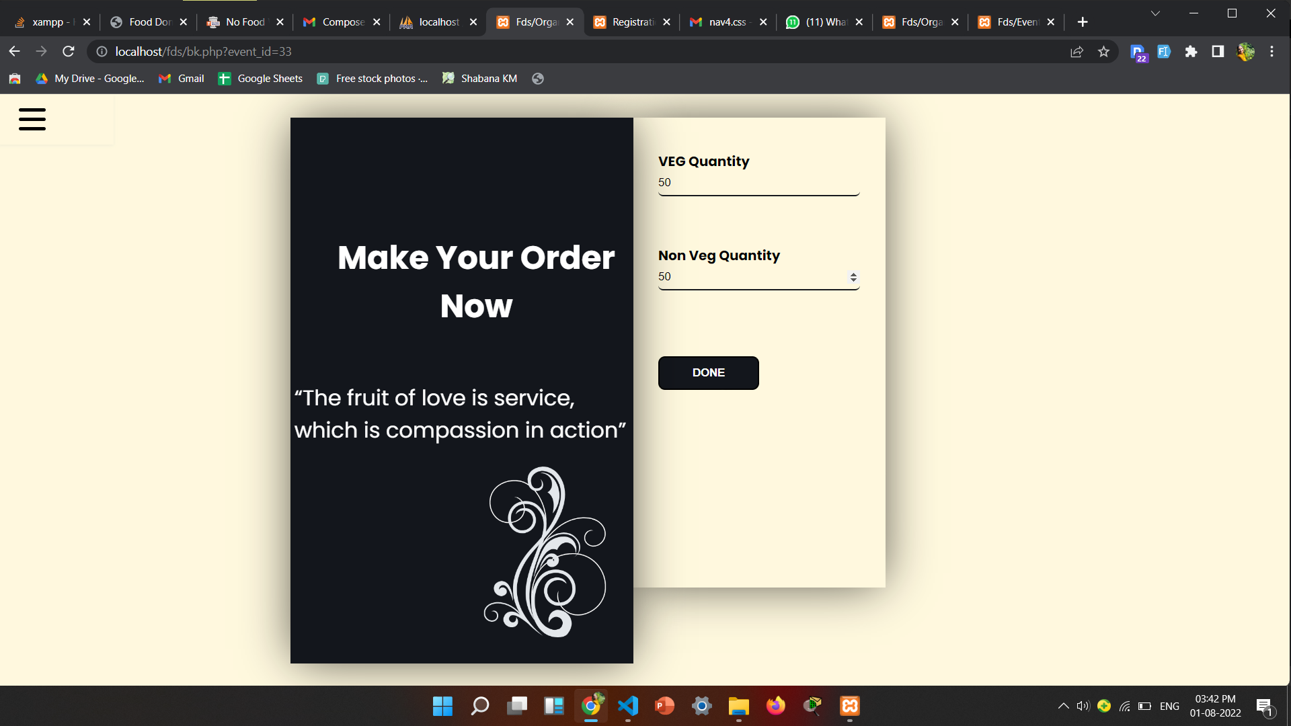
Booking Page

Slide 35
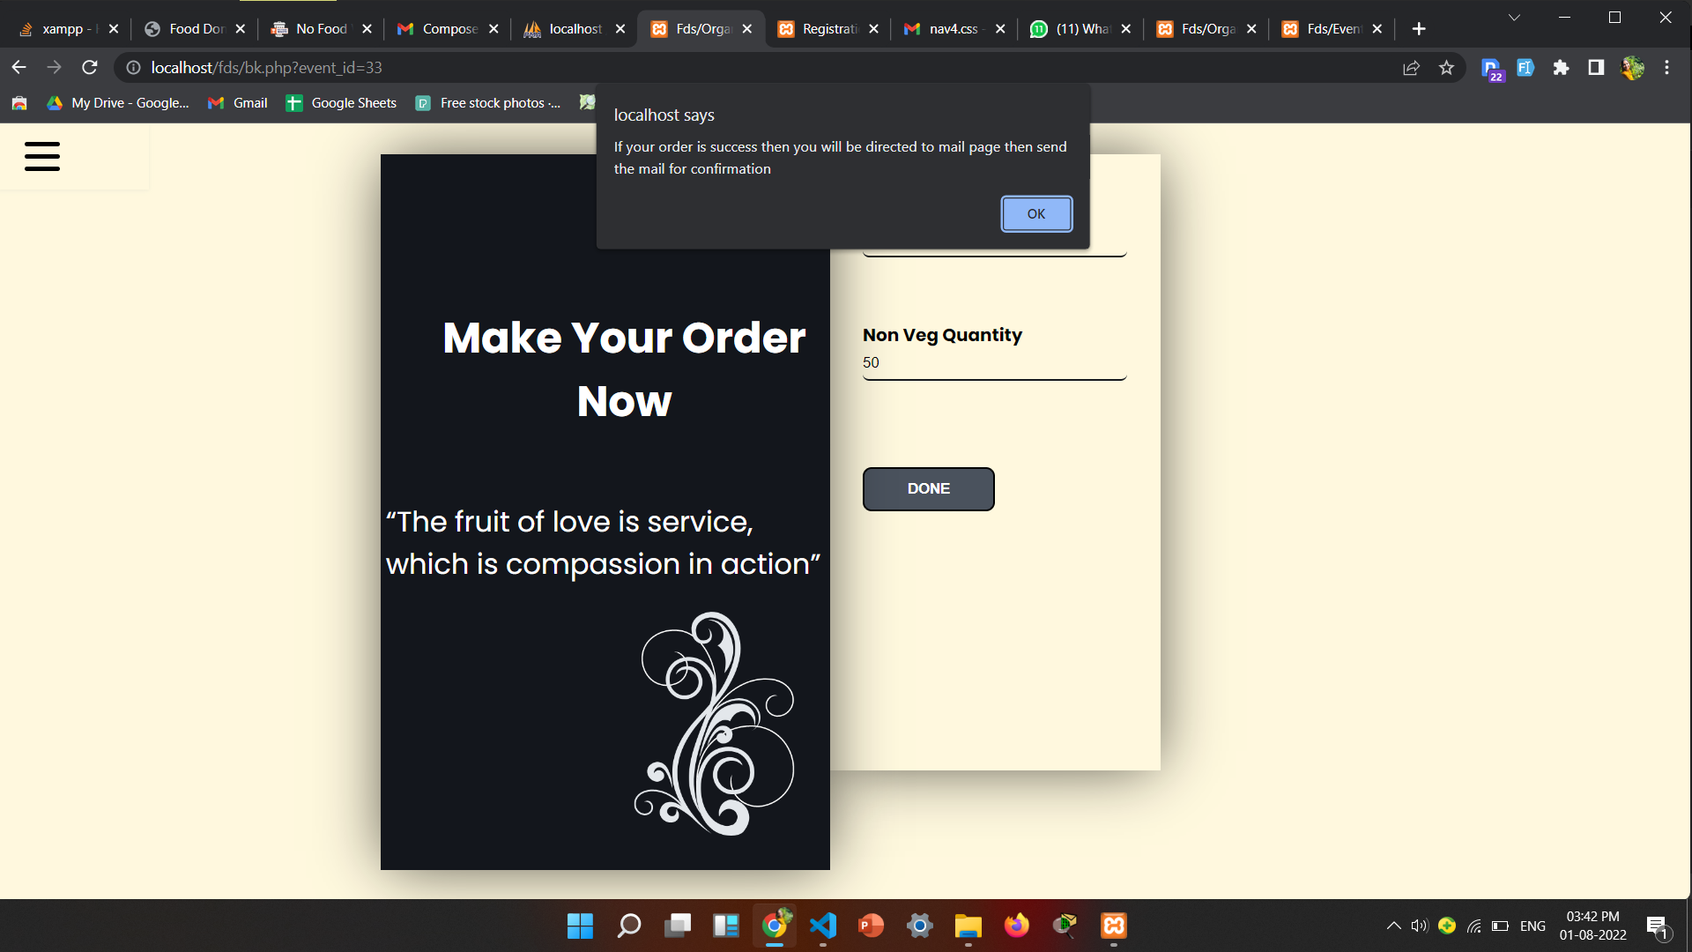
Booking

Slide 36
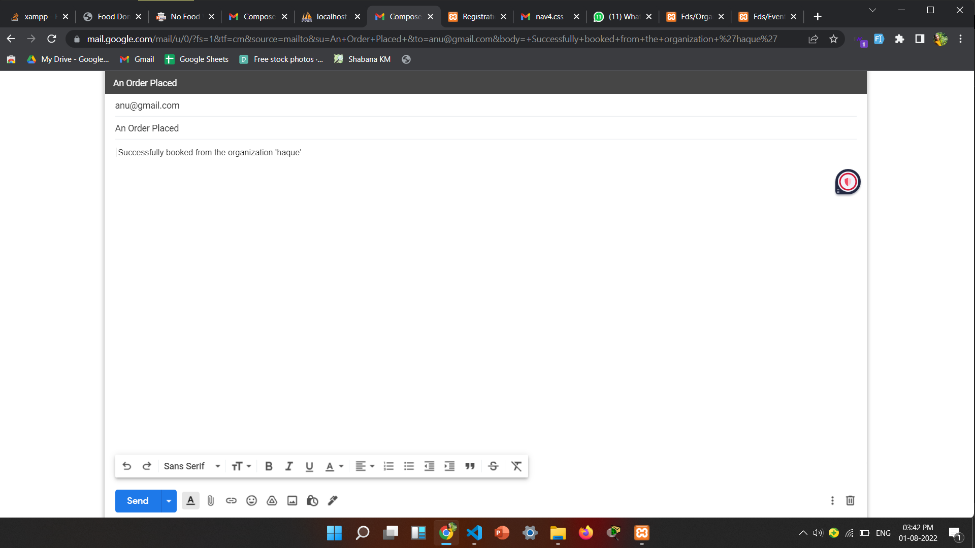
Mail

Slide 37
Limitations
Limited to a distance

Slide 38
Future Work
Distance needs to be shortened

Slide 39
Team Members
Anjitha Nair-Frontend
Christina Susan Jacob-Frontend
Fathima N K-Backend
Shabana KM-Backend

Slide 40
References
www.youtube.com
https://www.mysql.com
www.w3schools.com
https://www.php.net
www.coursera.org
www.tutorialspoint.com

